Slide 1


( One Stop Solution For Hassel Free Parking)
Department of Electronics & Communication Engineering
Dr. Akhilesh Das Gupta Institute of Technology & Management
Guru Gobind Singh Indraprastha University
Dwarka, Delhi-110078.
MARCH - 2022.
Group Members : AYANABHA PAUL (20415602818)
HARSHIT BAJAJ (20815602818)
ARYAN GANDHI (35215602818)
MANISH GOEL (20715602818)

Slide 2
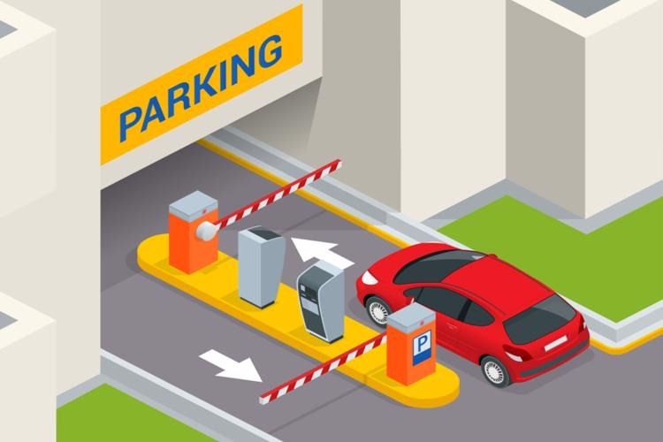
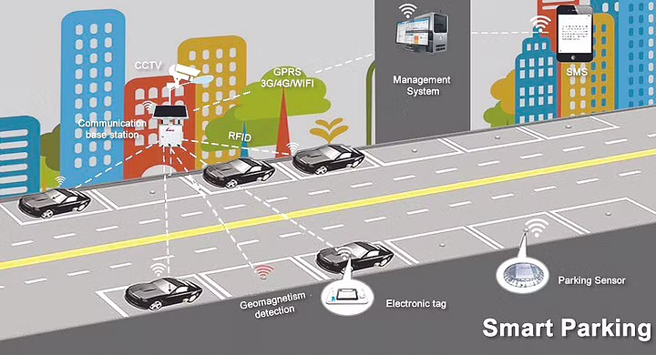
INTRODUCTION
PARKESY has a clear vision of the future: We connect Parking, Mobility and Urban life by providing innovative, smart solutions to our clients and their customers.
At PARKESY our mission is to achieve this vision by striving to not just be a mere service provider, but a reliable and trusted partner. We offer a comprehensive range of innovative services and products for our clients and customers. Integrity and loyalty are indispensably part of our company philosophy.

Slide 3
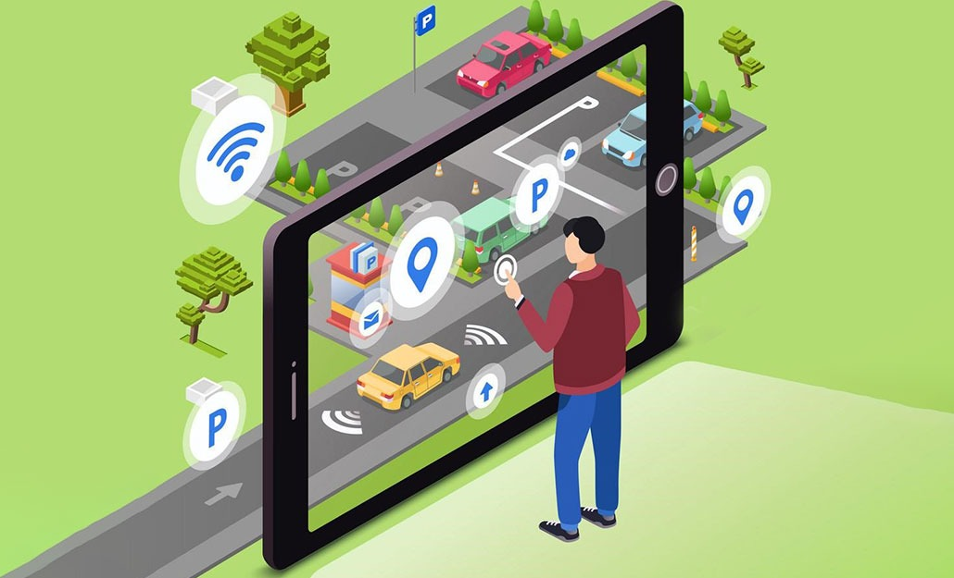
OUR OBJECTIVE
PARKESY is a Online Vehicle Parking Reservation System (OVPRS) that enables customers/drivers to reserve a parking space.
PARKESY was developed because the congestion and collision of the vehicle, the system was developed for people of Delhi .Therefore the project aimed at solving such problems by designing a web based system that will enable the customers/drivers to make a reservation of available parking space

Slide 4
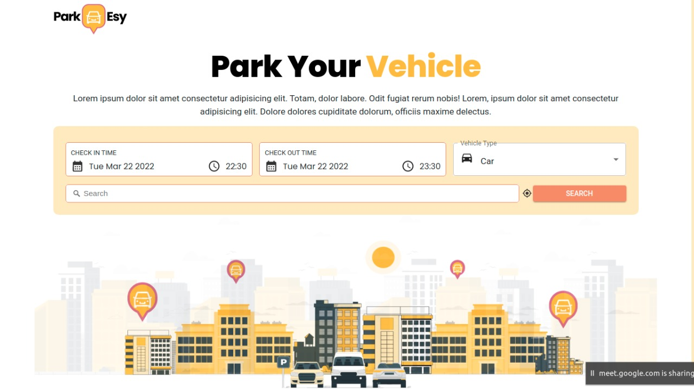

Slide 5
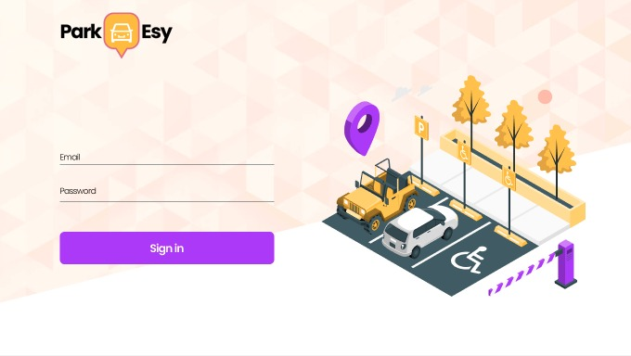

Slide 6
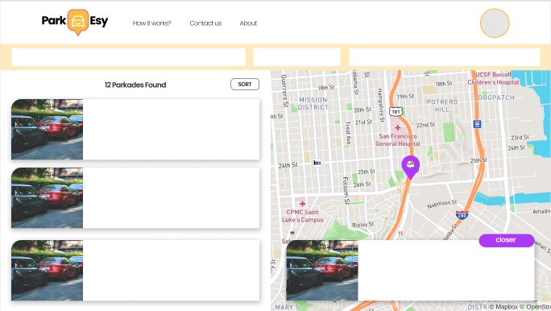

Slide 7
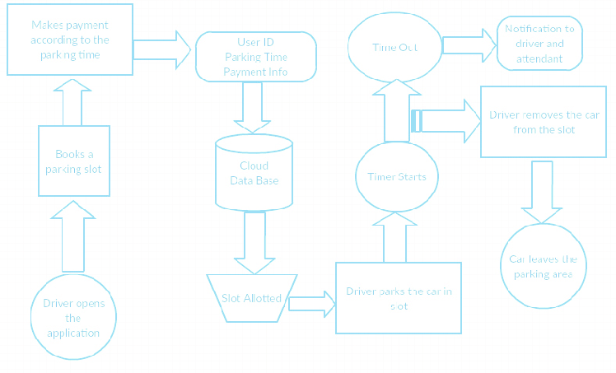
BLOCK DIAGRAM

Slide 8
PROJECT REQUIREMENTS
SOFTWARE
HARDWARE
ReactJS
Advanced CSS/SasS
MongoDB
Mongoose
ExpressJS
Redux(state management tool)
GIT(VCS)
Arduino uno
HC-SR04 distance measurement sensor
ESP8266 microcontroller

Slide 9
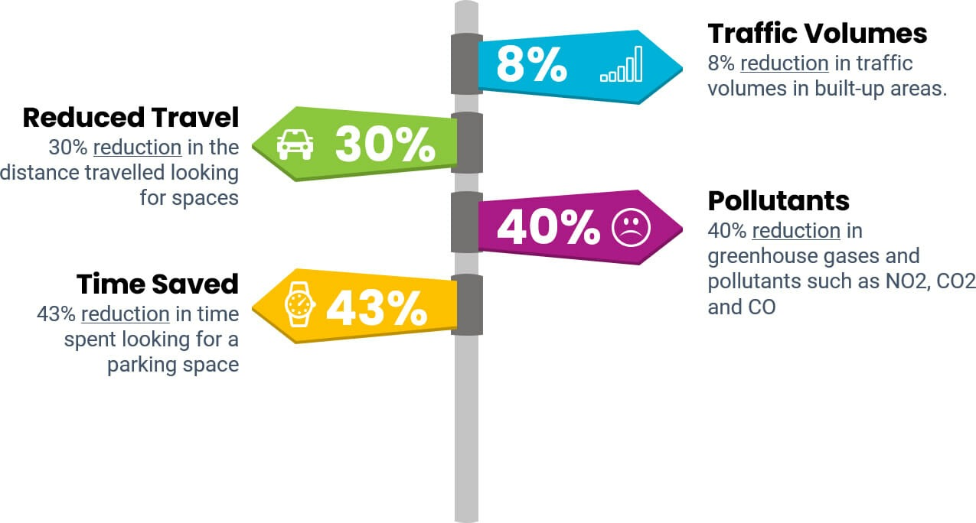
ADVANTAGES
Reduced Travel by 30%
Reduce search time by 43%
Reduce traffic volumes by 8%
Reduce pollutants by 40%

Slide 10
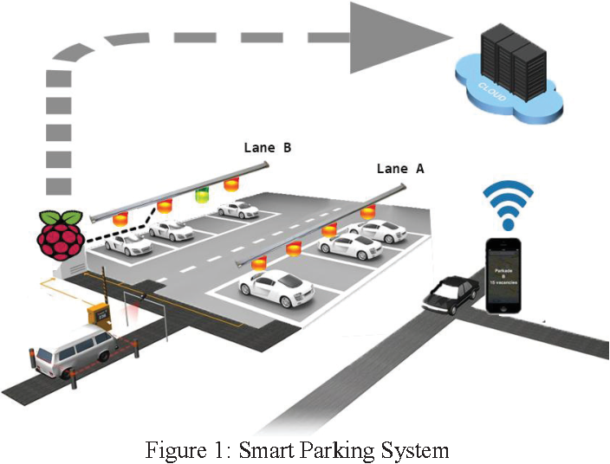
CONCLUSION
The efforts made in the project are focused mainly on improving a city’s parking facilities and thus aiming to improve its people’s quality of life.
In this project , we addressed the parking issue and present a integrated smart parking system based on IoT .

